Slide 1
Analyse IMDB score with data mining algorithms
Abhishek Vyas MT19086

Slide 2
Introduction
Success of a movie is not only entertains audience, but also a source of huge profit for film companies and box ofﬁce success absolutely essential for the survival of the industry.
Knowing which movies are likely to succeed and which are likely to fail before the release could beneﬁt the production houses.
Here we are trying to analyse what kind of movies are more successful and what are factors that may affect the success of movies.
We classify the movies into different classes of IMDB score (success criteria ) which depends on various factors (attributes).
Also analyse affect of different factors ( attributes ) on IMDB score.

Slide 3
DataSet Description
In this project, we use dataset from Kaggle website which contains 28 attributes for 5043 movies.
Some of the attributes have numeric value (as director-name, acotor-1-name,country …. ) while some have non-numeric values (as imdb-score, num-voted-user, num-critic-for-reviews …..),so we have to use different pre-processing steps according to their type.
DataSet have few duplicate rows in our data that need to be handle.
Few attributes have high percentage of null values ( as gross (31.21%), budget(17.39% ),aspect-ratio(11.67 %)….)
Some of the predictor (attributes ) are nearly constant as have only certain values which covers more than 90% of rows for that attributes. E.g. more than 95% of movies are color , similar trend is followed in country and language.

Slide 4
Data Exploration
Following steps as followed to pre-processing of the data :-
Remove duplicate rows:- earlier 5043 rows , after deletion 4998 rows
Check if any row have Null value in all attributes :- No such row found
Find percentage of null values in each attribute :- different steps are taken for different type of attributes
Type1 (attributes with high% of null values as gross 31.214286, budget 17.392857 aspect_ratio 11.678571, content_rating 10.750000) :- remove all rows having null values in given attributes (only around 24% so now we have deleted all such rows)
Type2 ( numeric attributes):- 1. Replace all zeroes with NA/Null.
2. Replace NA with mean value of column values.
Type2 ( non-numeric attributes):- Replace all Null values with most frequent value in given column.
Make various graphs using matplot and with tableau and try to find trend in Dataset

Slide 5
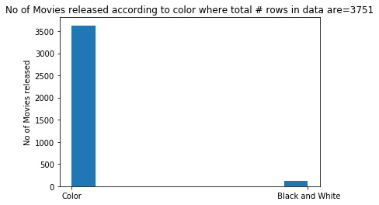
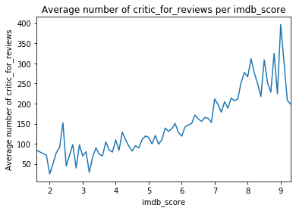
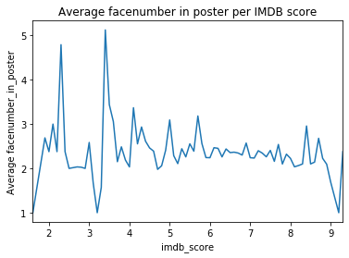
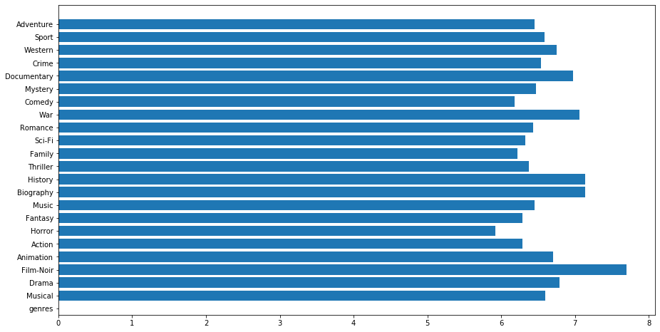
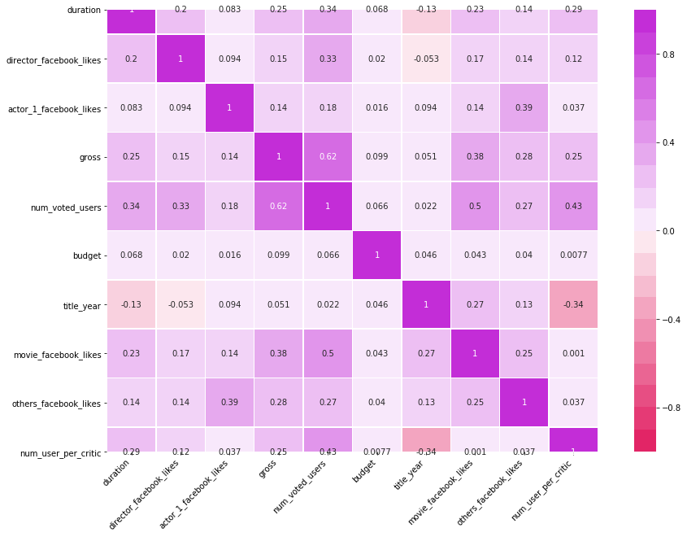
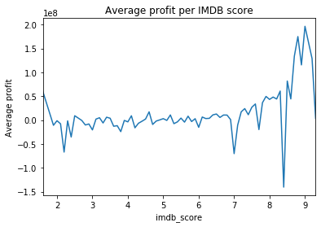
Data Exploration Continue…..
Use Graphs to Visualise The trend in data :-few graphs are as follows

Slide 6
Data Exploration Continue…..
Conclusion of Exploration
Few attributes are nearly constant as:- color, language, country (certain value repeat)
IMDB dependence on attributes and select and delete attributes accordingly
Add attributes Profit and Profit percentage :- Profit increase with IMDB score.
Make new attributes by splitting genre attribute and find relation of all genre with IMDB score:- all genre have nearly same IMDB score in range (6 to 8) :-delete attr.
Few attributes have large number of unique values as movie titles :-delete such attr.
Make correlation Heat map and found few attributes are highly correlated as cast-total-facebook-like and actor-1-facebook-like, make new attributes to handle
Make class imdb-score attributes as “A”([8,10], “B”[7-8), “C”[6-7), “D”[5-6), “E”[0-5)
Delete and select attributes on basis of above analysis and finalise attributes for classification and label encode data before using
Split data into Training and testing data in ration 7:3

Slide 7
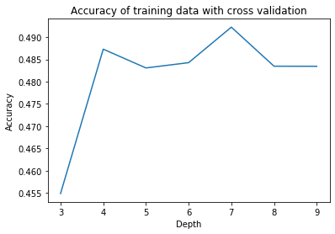
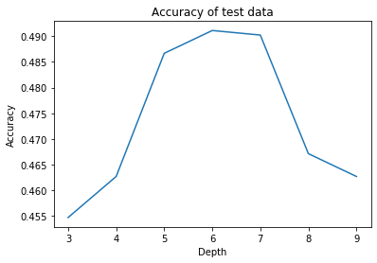
Decision Tree Classifier
Check mean-cross validation accuracy at k=5, gini-criteria at different depth
Max accuracy at depth=8
Accuracy =49%
Accuracy on test data using gini-criteria at different depth
Max accuracy at depth=6
Accuracy = 48.5%

Slide 8
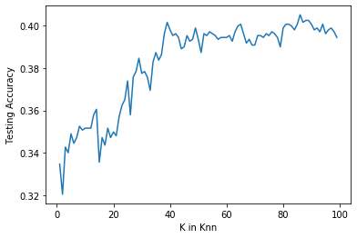
K-NN Classifier
Use sklearn library to implement K-NN Classifier
As we pass only value of n-neighbour as parameter,it takes default value of other parameters as p which is Power parameter for the Minkowski metric.It is equivalent Euclidean-distance for p=2.
We don’t‘ know best value of k so find accuracy for range 1 to 100
Highest Accuracy at k=82
Accuracy=40.05%

Slide 9
Random Forest with and without LDA
Random forest classifier creates a set of decision trees from randomly selected subset of training set. It then aggregates the votes from different decision trees to decide the final class of the test object
WITHOUT LDA(Linear discriminant analysis)
From sklearn.ensemble we use Randomforest classifier
use parameter as max-depth=2 and random-state = 0.
Accuacy=42.09 %
LDA=>LDA tries to reduce dimensions of the feature set while retaining the information that discriminates output classes. LDA tries to find a decision boundry around each cluster of a class.

Slide 10
Random Forest without and with LDA
WITH
Using LDA we fit the X-train and X-test ie the features of training and testing data and use these features to train our Random forest model and than find accuracy as before.
Accuracy=45.73%

Slide 11
Classification using Support Vector Machine
We use sklearn library to use svm classifier.
We train the svm modal using our training data
And predicted the values using that modal on test data. And than find Accuracy using real and predicted value of IMDB Class.
We get Accuracy =37.56%

Slide 12
Conclusion
Model | Accuracy
Decision Tree Classifier | 48.5%
KNN Classification | 40.5%
Support Vector Machine | 37.56%
Random Forest without LDA / with LDA | 42.09 / 45.73%
After applying the five models, we conclude that Decision Tree Classifier model give the highest accuracy .It predict IMDB Score class more accurately as compare to other classifier.
Our overall accuracy move in range of 35 to 48 it is quite low to use modal in real life.
In my inference the reason of low accuracy is less amount of data. In starting we have 5043 rows of data to train which remain to around 3500 after various pre-processing steps .
Large data set will be helpful for finding the accuracy.

Slide 13
Thank You

